Slide 1
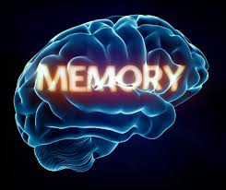

Slide 2
What Is Memory?
Our memory helps make us who we are.
It allows us to function in our daily lives, forge relationships that are vital for our well-being, and remember important events from our past
Memory refers to the psychological processes of acquiring, storing, retaining, and later retrieving information. Memory involves three major processes: encoding, storage, and retrieval.
Memory is the term given to the structures and processes involved in the storage and subsequent retrieval of information.

Slide 3
How Memories Are Formed
In order to create a new memory, information must be changed into a usable form, which occurs through a process known as encoding. Once the information has been successfully encoded, it must be stored in memory for later use.
Memories are created through the connections that exist between these neurons—either by strengthening these connections or through the growth of new connections
This is why reviewing and rehearsing information improves the ability to remember it.
Practice strengthens the connections between the synapses that store that memory.

Slide 4
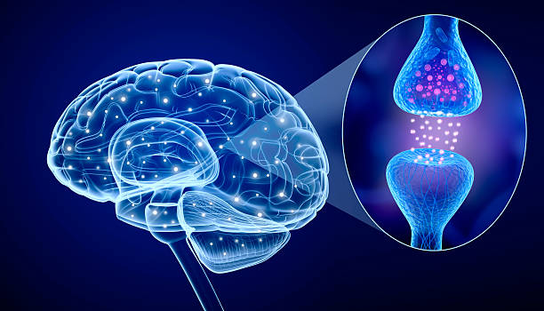
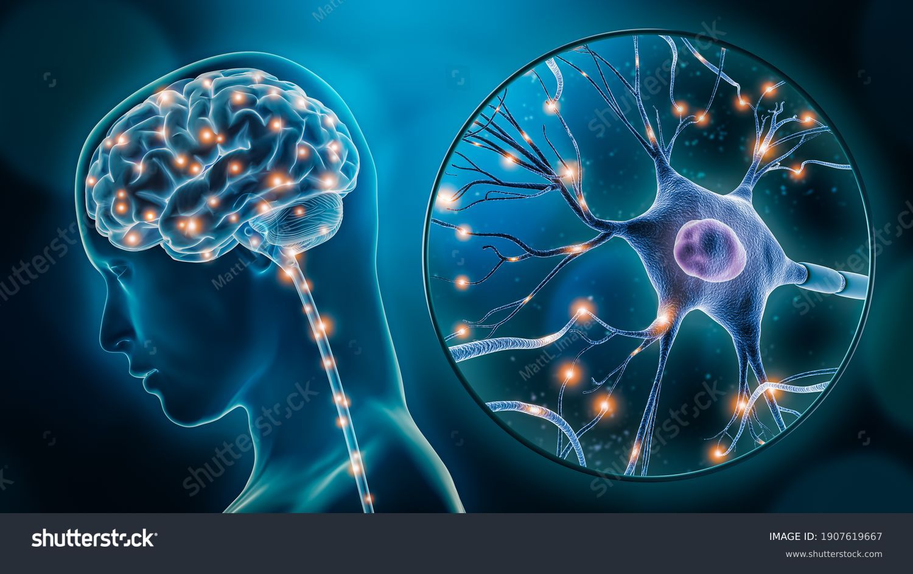
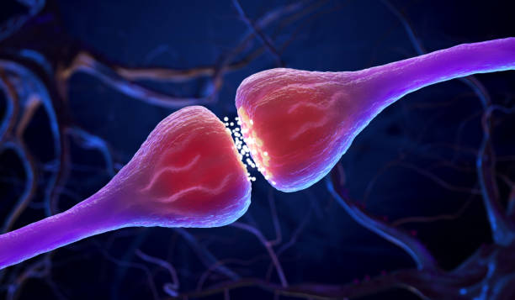

Slide 5
Parts of the brain involved in memory
The Hippocampus (forming long-term memories),
Amygdala (emotional memories),
Prefrontal cortex (short-term/working memory),
Cerebellum (procedural and skill-based memories), and
The Cerebral cortex (storing long-term memories).
These structures work together within the limbic system and across the brain to encode, consolidate, and retrieve different types of information

Slide 6
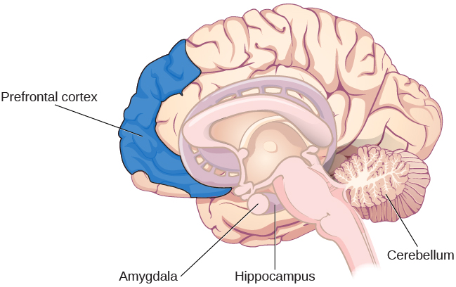

Slide 7
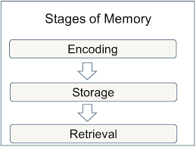
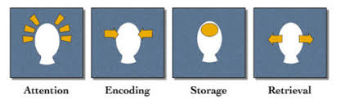
There are three main processes that characterize how memory works. These processes are
Encoding
Storage and
Retrieval (or recall).

Slide 8
Encoding. Encoding refers to the process through which information is learned. That is, how information is taken in, understood, and altered to better support storage
Information is usually encoded through one (or more) of four methods:
(1) Visual encoding (how something looks);
(2) acoustic encoding (how something sounds);
(3) semantic encoding (what something means); and
(4) tactile encoding (how something feels).
While information typically enters the memory system through one of these modes, the form in which this information is stored may differ from its original, encoded form

Slide 9
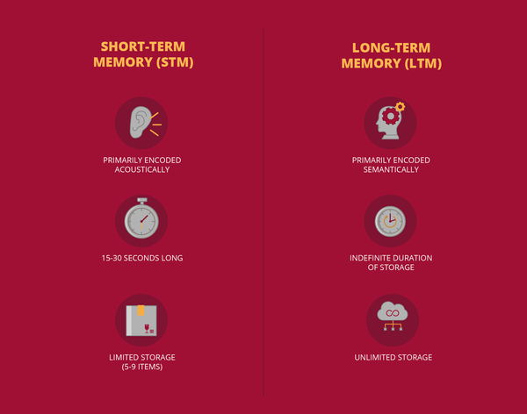
Storage. Storage refers to how, where, how much, and how long encoded information is retained within the memory system .
(storage) highlights the existence of two types of memory: short-term and long-term memory.

Slide 10
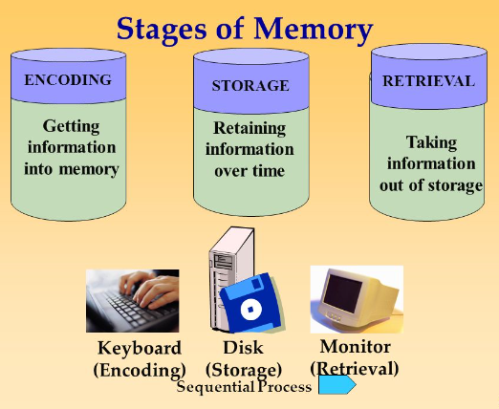
Retrieval- retrieval is the process through which individuals access stored information.
This refers to getting information out of storage.

Slide 11
Stages of memory
Information begins in sensory memory, moves to short-term memory, and eventually moves to long- term memory.
Also known as Multi store Memory model or Atkinson-Shiffrin model of memory
But not all information makes it through all three stages; most of it is forgotten.
Whether the information moves from shorter-duration memory into longer-duration memory or whether it is lost from memory entirely depends on how the information is attended to and processed.

Slide 12
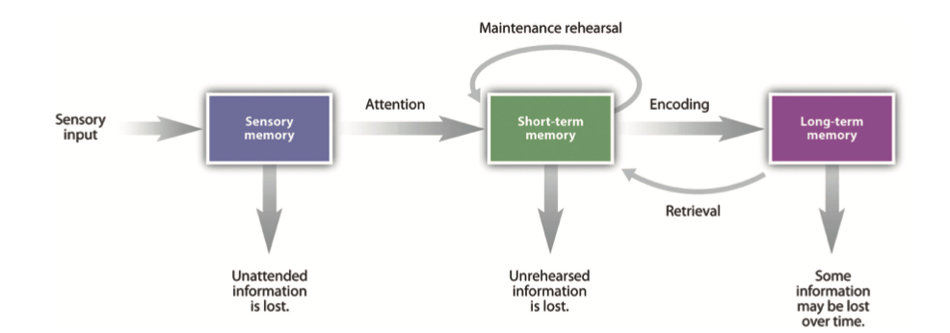

Slide 13
Sensory Memory
Sensory memory refers to the brief storage of sensory information.
Sensory memory is a memory buffer that lasts only very briefly and then, unless it is attended to and passed on for more processing, is forgotten.
The purpose of sensory memory is to give the brain some time to process the incoming sensations and to allow us to see the world as an unbroken stream of events rather than as individual pieces.
Visual sensory memory is known as iconic memory. Iconic memory was first studied by the psychologist George Sperling (1960)

Slide 14
Auditory sensory memory is known as echoic memory.
In contrast to iconic memories, which decay very rapidly, echoic memories can last as long as 4 seconds (Cowan et al.,).
This is convenient as it allows you—among other things—to remember the words that you said at the beginning of a long sentence when you get to the end of it

Slide 15
Short-Term Memory
Most of the information that gets into sensory memory is for- gotten, but information that we turn our attention to, with the goal of remembering it, may pass into short-term memory.
Short-term memory (STM) is the place where small amounts of information can be temporarily kept for more than a few seconds but usually for less than one minute
Information in short-term memory is not stored permanently but rather becomes available for us to process, and the processes that we use to make sense of, modify, interpret, and store information in STM are known as working memory.

Slide 16
Long-term memory
Long-term memory (LTM) is the final stage of the multi-store memory model proposed by Atkinson-Shiffrin, providing the lasting retention of information and skills.
Theoretically, long-term memory capacity could be unlimited
Long-term memory refers to the memory process in the brain that takes information from the short-term memory store and creates long lasting memories. These memories can be from an hour ago or several decades ago.
Short-term memories become long-term memories in a region of the brain called the hippocampus.
Another part of the brain called the cortex stores these long-term memories.

Slide 17
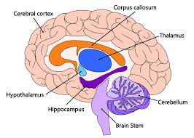
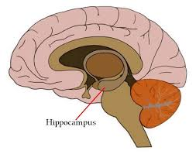

Slide 18
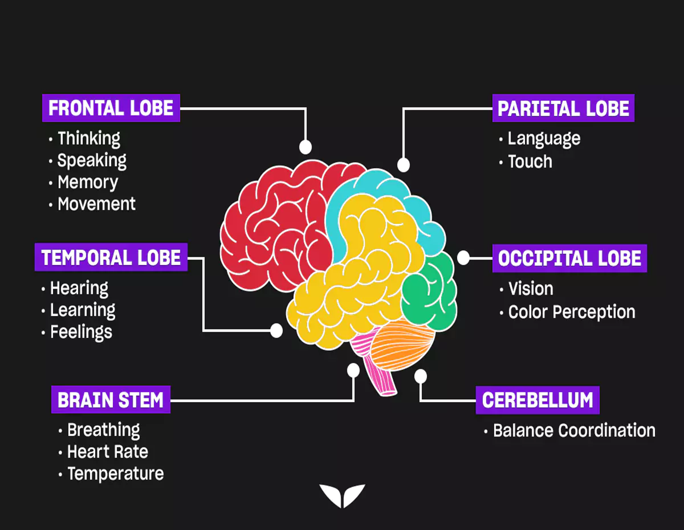
Parts of the Brain Involved in Learning & Memory
F-Frontal Lobe for thinking and Analysis
A- Amygdale Hippocampus for Recent Memory. That is Short Term Memory.
T- Temporal Lobe for hearing, smell & Taste
H- Hind Brain for Visual Images

Slide 19
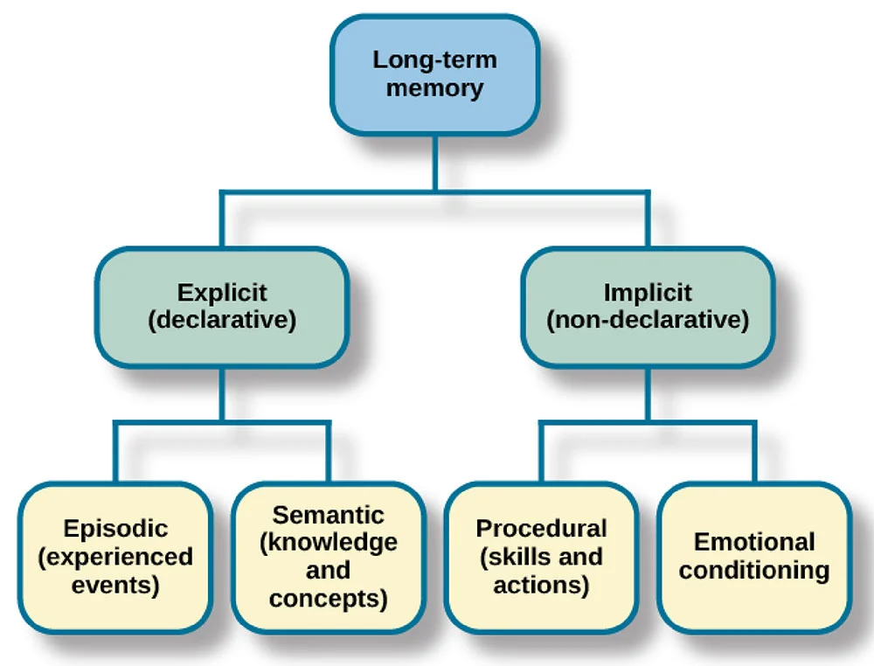
Types of Long-Term Memory
Long-term memory is not a single store and is divided into two types: explicit (knowing that) and implicit (knowing how). One of the earliest and most influential distinctions of long-term memory was proposed by Tulving (1972).

Slide 20
Procedural Memory
Procedural memory is a part of the implicit long-term memory responsible for knowing how to do things, i.e., memory of motor skills.
It does not involve conscious (i.e., it’s unconscious-automatic) thought and is not declarative. For example, procedural memory would involve knowledge of how to ride a bicycle.
Semantic Memory
Semantic memory is a part of the explicit long-term memory responsible for storing information about the world. This includes knowledge about the meaning of words, as well as general knowledge.
For example, London is the capital of England. It involves conscious thought and is declarative.
The knowledge that we hold in semantic memory focuses on “knowing that” something is the case (i.e. declarative).
For example, we might have a semantic memory for knowing that Paris is the capital of France.

Slide 21
Episodic Memory
An episodic memory is a memory of a specific event. Because each person has a different perspective and experience of an event, episodic memories of that event are unique to each person.
Imagine that you get a phone call from an old school friend. You spend an evening reminiscing about amusing moments from your days at school. Your memories of those specific events and experiences are examples of episodic memory
Episodic memories are important for shaping your personal sense of identity. These memories provide you with a sense of personal history and a shared history with others in your life. Episodic memory has a profound effect on your life. Tulving described it as a "mental time machine."

Slide 22
Factors that determine Learning & Memory
Growth and development of the brain
I.Q.
Attention span and level of concentration
Motivation to learn and remember
Nature and usefulness of information
Physical health
Mental health
Quality of teaching
Environment
Study habits

Slide 23
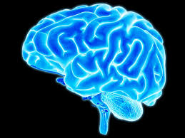
Growth and Development of the Brain
Growth of the brain occurs right from 9 months of pregnancy and first five years of life
Fully grown brain weighs 1250 gms and contains 100 billion nerve cells.
Higher order brain functioning takes place during 18-20 yrs of age. Again it varies from individual to individual based on the following factors.

Slide 24
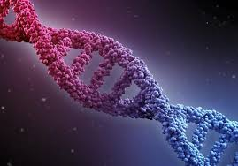
Genetic issues- chromosomal abnormalities may lead to poor development of brain. Eg.Microcephaly, Down’s syndrome.
Prenatal factor- if the pregnant mother suffers from viral infections like chicken pox, measles, hepatitis etc, during the first three months of pregnancy or from syphilis, AIDS, diabetes mellitus the growth of the brain of the foetus is arrested. This results in M.R(Mental retardation of the child.

Slide 25


Poor nutrition- Protein,iron, iodine deficiency in the pregnant woman and in turn the child lead to poor development of brain
Misuse of drugs- consumption of alcohol, tobacco and other intoxicating substances by the pregnant women.
Birth trauma- complicated, delayed delivery and difficulties faced during labor may cause damage to the brain of the child

Slide 26
Diseases during childhood-repeated vomiting, diarrhea, fits, jaundice, head injury, brain fever during first five years of life can cause brain damage.
Environmental stimulation- in a barren environment, where there are no adequate stimulation to the five senses of the child, no interactions with parents and environment can delay the maturation of the brain cells.

Slide 27
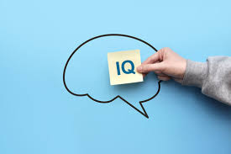
Intelligent Quotient
It is calculated by the formula
M.A/C.A*100
MA- Mental age
CA-Chronological age (age in years)
MA- score of Stanford Binet test
Those who have an I.Q below 70 are retarded
I.Q is the product of genetics, nutrition and environment.
Men are generally good in problem solving. Women are good in reasoning, word fluency and memory
I.Q is not a static phenomenon. It keeps changing. Good health, mental equilibrium and pleasant challenging environment improve the intellectual functioning of the individual.

Slide 28
Attention Span & Concentration
Two factors- Internal & External
Internal
Fasting & Feasting- If the adolescent is fasting or took food 5 to 6 hrs ago, the glucose level in the blood drops to 60 mg per 100 ml.
This Hypoglycemia makes the individual Unable to sustain his/her attention and concentration.
On the other hand , if he had taken very high calorie diet, he feels drowsy and fails to concentrate.
Pain and discomfort in the body
Dissatisfaction and disappointments
Worries about family, finance and future
Negative emotions like fear, sadness, anger, jealousy, inferiority

Slide 29
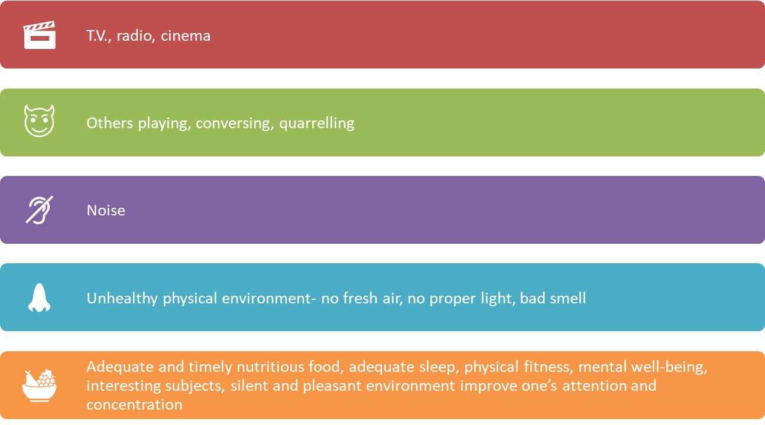
External factors

Slide 30
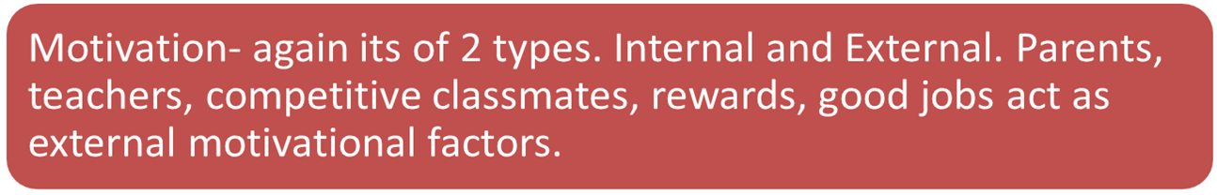
Acquiring knowledge, need to excel oneself , awareness of the value of education in the personality development and in the management of life events are the internal motivating factors

Slide 31
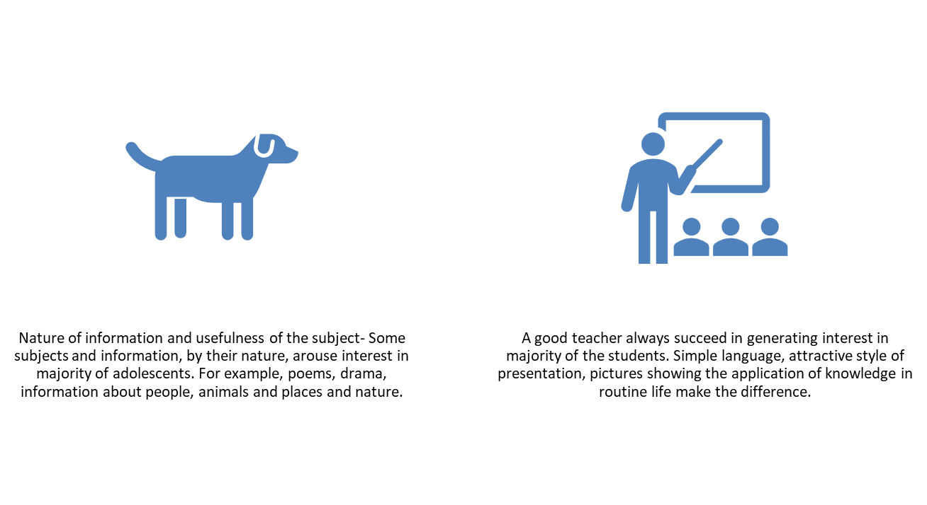

Slide 32
Physical Health
Mental health- anxiety disorders, identity crisis, performance anxiety, the big gap between the realities of life and fantasies, lack of sexual education, social disorganization like unhealthy and unethical competitions, uncertain society, unequal distribution of wealth also leads to anxiety.
Depression, Hysterical disorder, Drug abuse

Slide 33
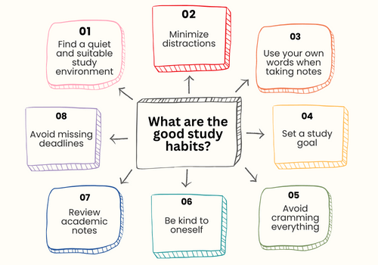
Good study habits

Slide 34


Slide 35
There are several different things that you can do to stay motivated during your studies. Some of the most effective tips include:
Set realistic goals for yourself and strive to accomplish as many of them as possible.
Make a study schedule and stick to it as closely as possible.
Take breaks regularly, but make sure that you set a specific time for when you will resume studying.
Find a study group to help keep you accountable and motivated.
Reward yourself for completing tasks or reaching milestones, but do not overindulge or get too caught up in rewards.
Be willing to adjust your goals or study habits if they are not working for you.
Keep a positive attitude and remember that even tricky tasks can be accomplished with enough effort and perseverance.
SQ3R Method

Slide 36
SQ3R Method
S- Survey- survey the headings and subheadings
Q- Questioning
R- Read- read the material carefully
R- Recite – after reading , recite the information from it
R- Review- review the entire information by quizzing yourself and then reread anything you fail to recall.

Slide 37
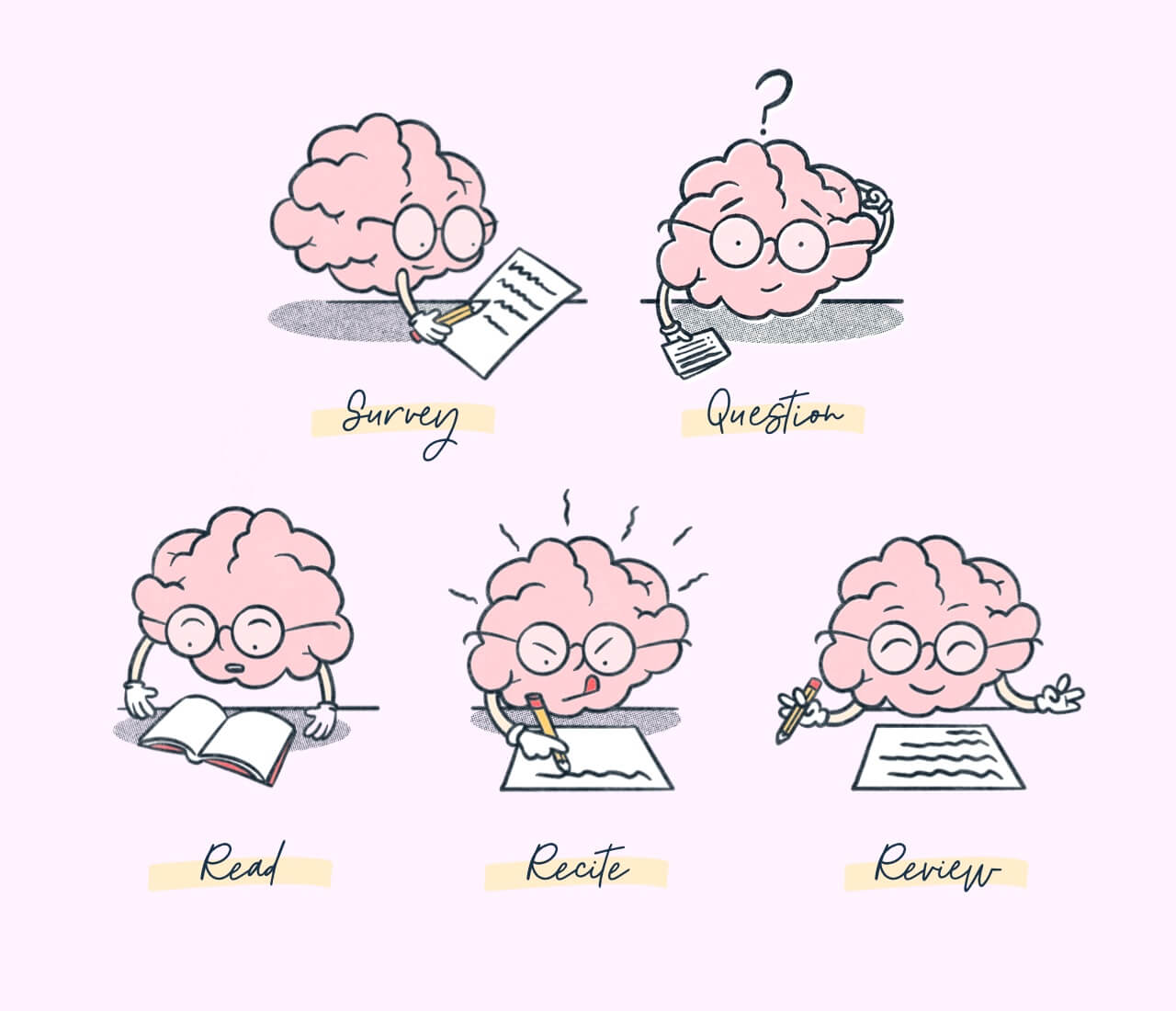
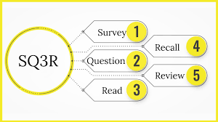

Slide 38
Memory Techniques
Mnemonic method:
It is also known as “Acronym”. Some times we have to learn and remember all information and their order. Eg: VIBGYOR
Method of loci :
It is a technique of visualization . The technique employs a series of “loci” or locations.
Chunking :
This is a systematic way of grouping information . Dividing words/numbers into meaningful manners.
Link method :narrative method in which unrelated items are connected in a story.

Slide 39
FORGETTING
Decay Theory
Idea: Memories fade over time if they are not used.
Like “traces” in the brain that weaken gradually.
Example: Forgetting a childhood classmate’s name because you haven’t thought of it for years.
Interference Theory
Idea: Forgetting happens because other information gets in the way.
Two types:
Proactive interference: Old memories block new learning. E.g., Using your old password when trying to recall a new one.
Retroactive interference: New learning makes it harder to remember old information. E.g., Forgetting your old phone number after memorizing a new one.

Slide 40
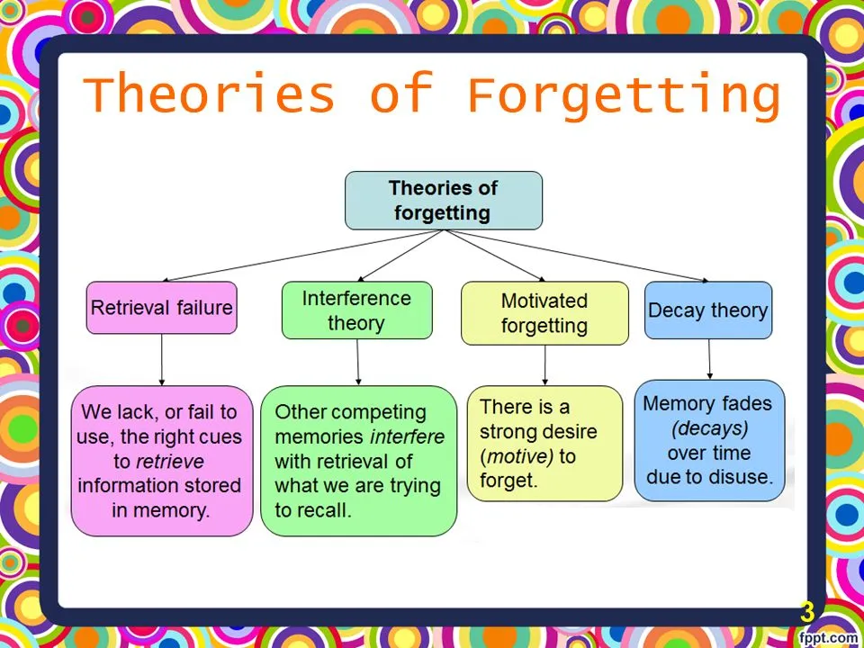

Slide 41
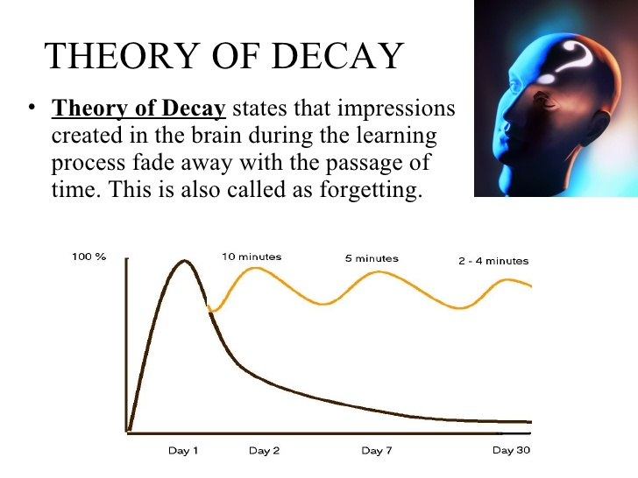

Slide 42
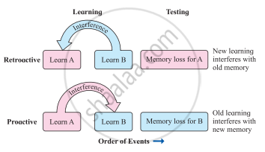
Interference Theory

Slide 43
